Slide 1
Industrial Communication µ-Projects
Amitojsingh Arora
Shunnoy Sarkar

Slide 2







Contents
Modbus RTU
HTTP Requests
Modbus TCP
CAN bus
CAN Joystick
IO link MQTT
ESP32 IO link device

Slide 3
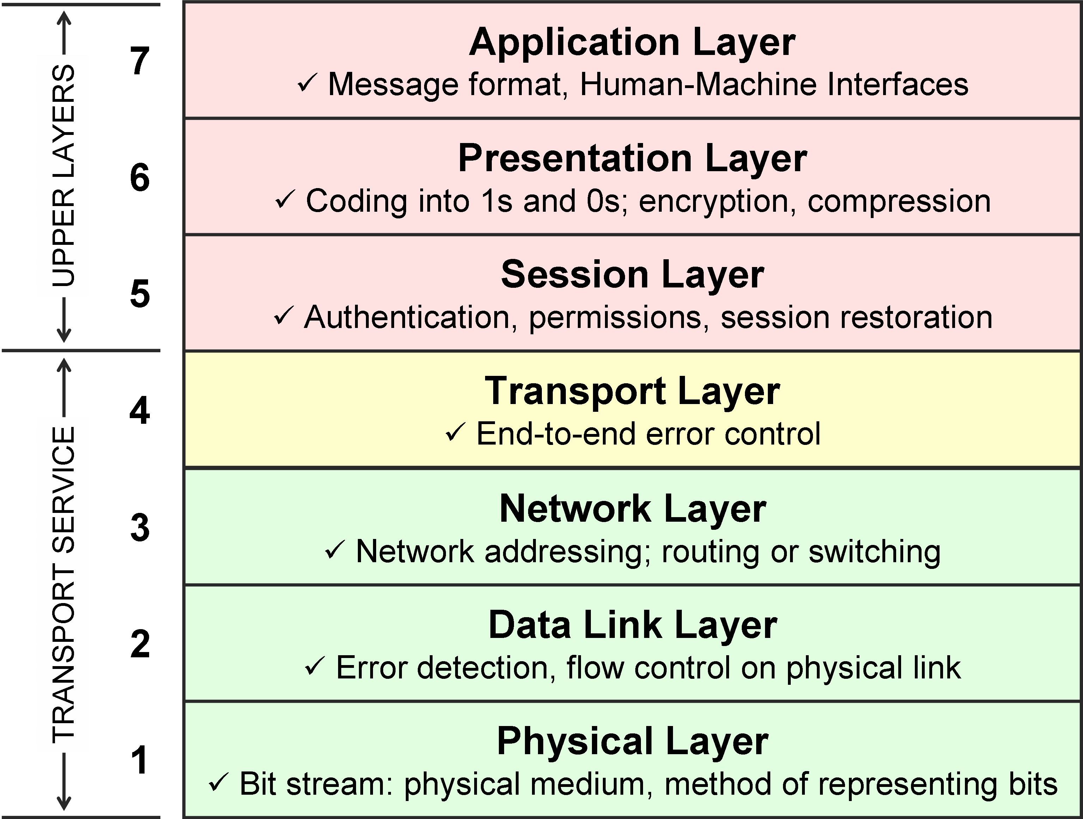
Modbus RTU
Node Red
Modbus RTU
RS 485 and Temp/Humidity Sensor

Slide 4
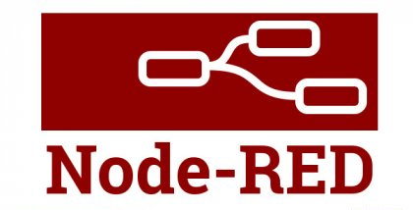
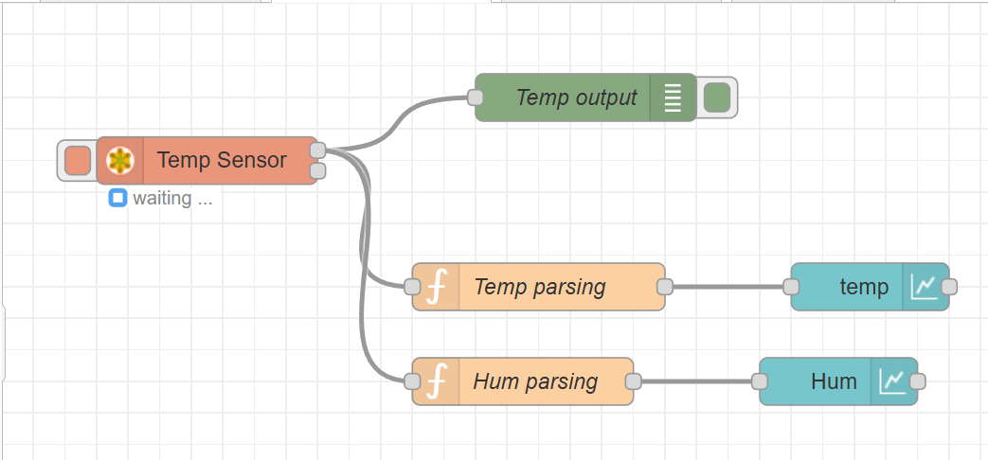
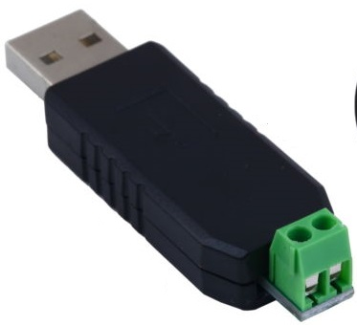
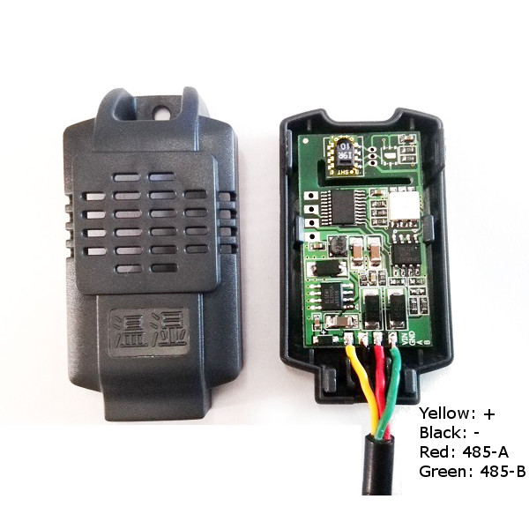
Modbus RTU
USB RS 485
Modbus Temp/ Hum sensor

Slide 5
Modbus TCP
Node Red
RS 485

Slide 6
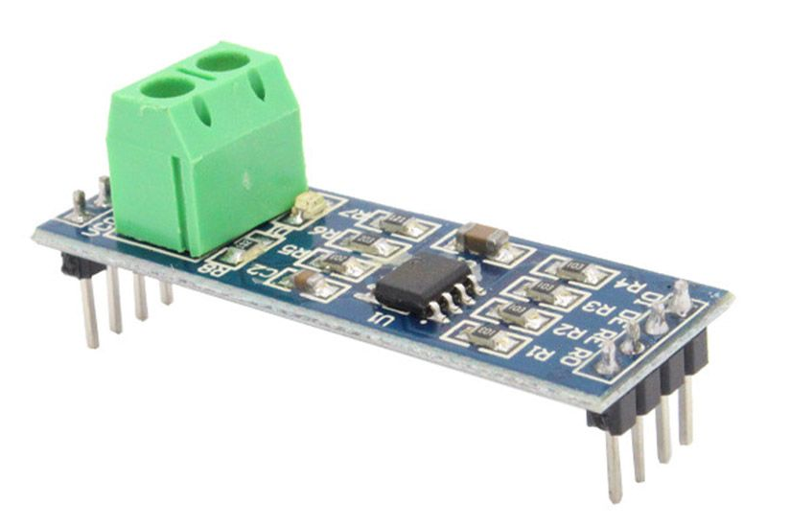
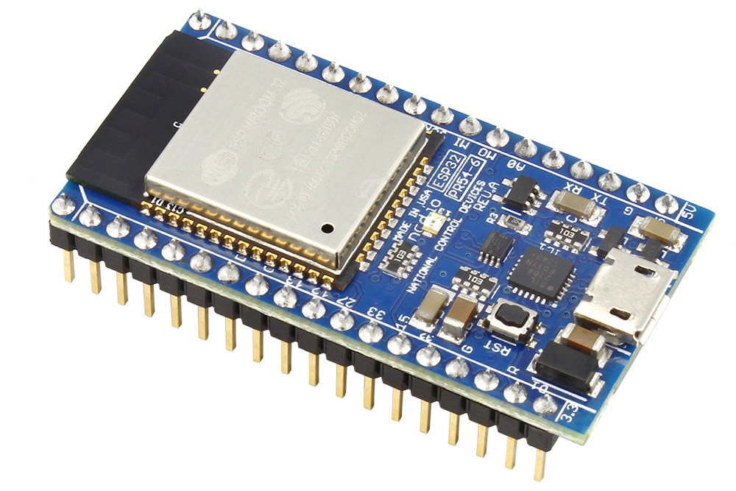

Modbus TCP
RS485 to TTL
ESP 32
Modbus Temp/ Hum sensor

Slide 7
CAN Bus
Node Red
Modbus RTU
RS 485

Slide 8
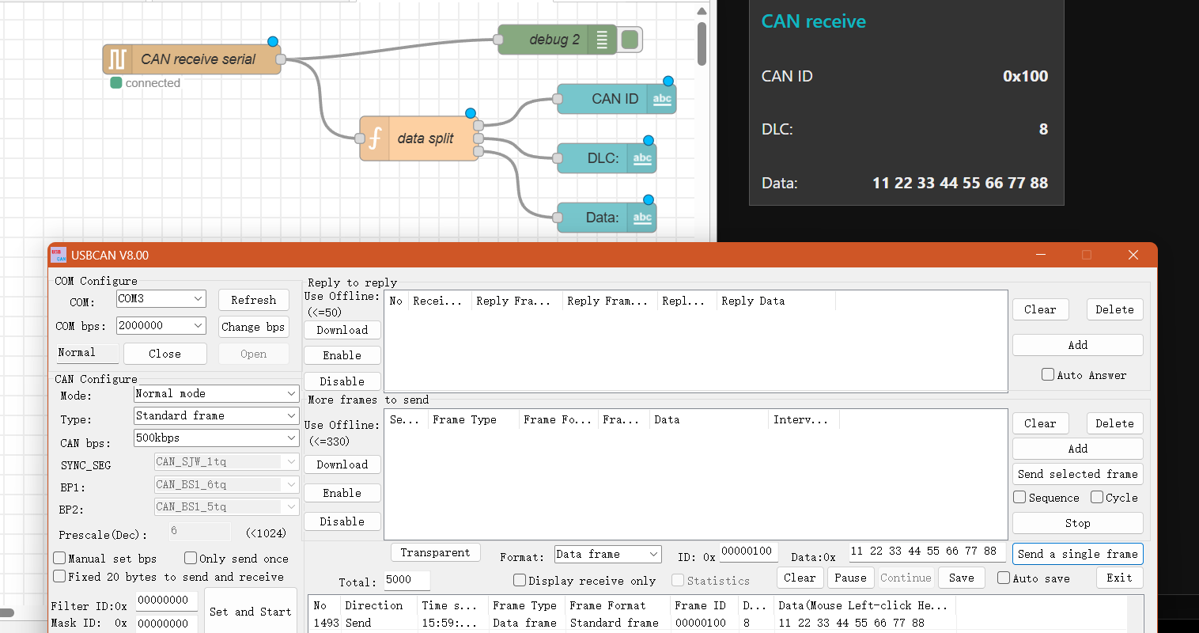
CAN Bus – Send example

Slide 9
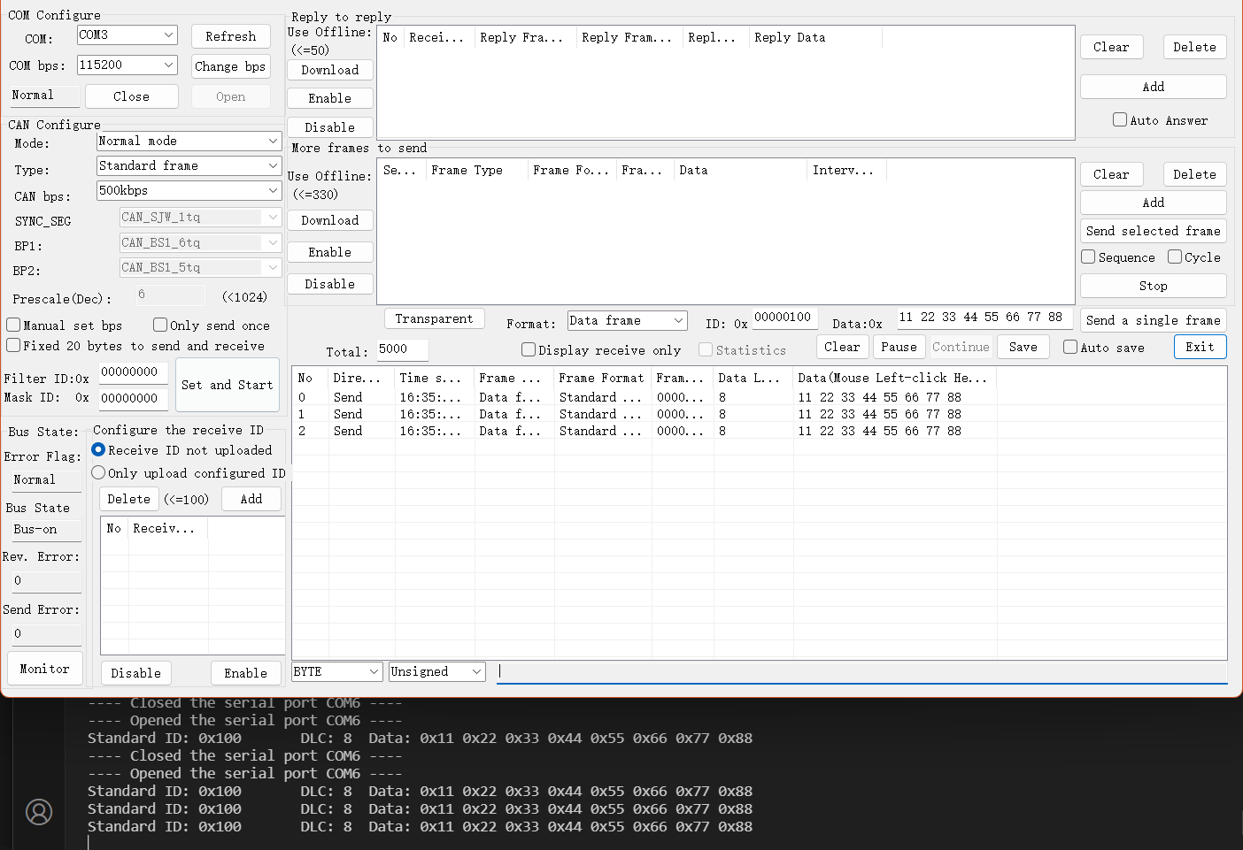
CAN Bus – Receive example

Slide 13
FH Aachen Fachbereich xxx Name Studierende(r) o. Seminar xxx Straße Nr. PLZ Ort

